Slide 1
Design Thinking-Persona
K.Sarmila
111622201095

Slide 2
What is Persona?
Personas are fictional characters, which you create based upon your research in order to represent the different user types that might use your service, product, site, or brand in a similar way.
Creating personas helps the designer to understand users' needs, experiences, behaviors and goals.

Slide 3
Personas Are More Than “People”
Personas are distilled essences of real users.
In user experience (UX) design, you use personas to build empathy with target users and focus on their world.
You should always create personas from observations about real users, personas should never be invented out of your assumptions about your users.
Because you must map your users’ needs to your design’s functionality, you must first clearly define both the needs and the users.

Slide 4
Types of Persona:
Goal Directed-Persona
Role Based Persona
Engaging Persona
Fictional Persona

Slide 5
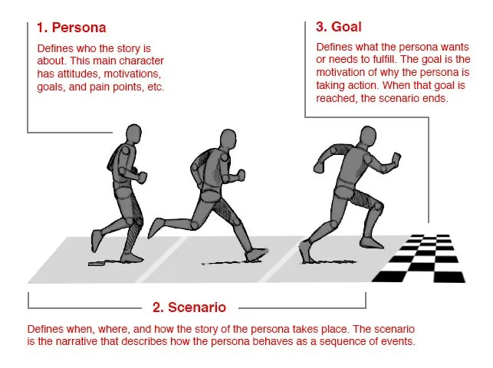
Goal Directed-Persona
The objective of a goal-directed persona is to examine the process and workflow that your user would prefer to utilize to achieve their goals in interacting with your product or service.

Slide 6
Role based Persona:
The role-based perspective is also goal-directed, and it also focuses on behavior.
The personas of the role-based perspectives are massively data-driven and incorporate data from both qualitative and quantitative sources.
The role-based perspective focuses on the user’s role in the organization

Slide 7
Engaging Persona
Engaging personas can incorporate both goal and role-directed personas, as well as the more traditional rounded personas.
These engaging personas are designed so that the designers who use them can become more engaged with them.
The idea is to create a 3D rendering of a user through the use of personas.
The more people engage with the persona and see them as ’real’, the more likely they will be to consider them during the process design and want to serve them with the best product

Slide 8
Fictional Persona
The fictional persona does not emerge from user research (unlike the other personas), but it emerges from the experience of the UX design team.
It requires the team to make assumptions based upon past interactions with the user base and products to deliver a picture of what, perhaps, typical users look like

Slide 9
To Create Effective Personas:
Collect extensive data on target users.
Determine the qualities of and differences between users.
Develop a hypothesis from the research, determining the qualities of and differences between users.
Ensure stakeholders agree on the hypothesis about the users.
Determine a number of personas – more than one per project, but focus especially on one.

Slide 10
Name and describe each persona in 1-2 pages
Describe several situations/scenarios prompting the persona to use your product – put him/her in contexts with problems to overcome.
Include everyone involved in the project so they’ll accept the persona or advise revisions.
Send them the persona to use in their work.
Ensure everyone develops scenarios – these should expose the persona optimally to potential use cases.
Make continuous adjustments – revisit the persona; add new features; add required new personas; discard outdated personas.

Slide 11
How to use Personas in Design Projects:
Stays in context
Reflects a target user’s real behaviour patterns,attitudes,skillset,motivations and goals within product’s domain,has an end goal?-What does the user want to achieve?
Faces realistic ,relevant scenarios-written from persona’s perspective
Occupies a clear setting
Has visible pain points

Slide 12
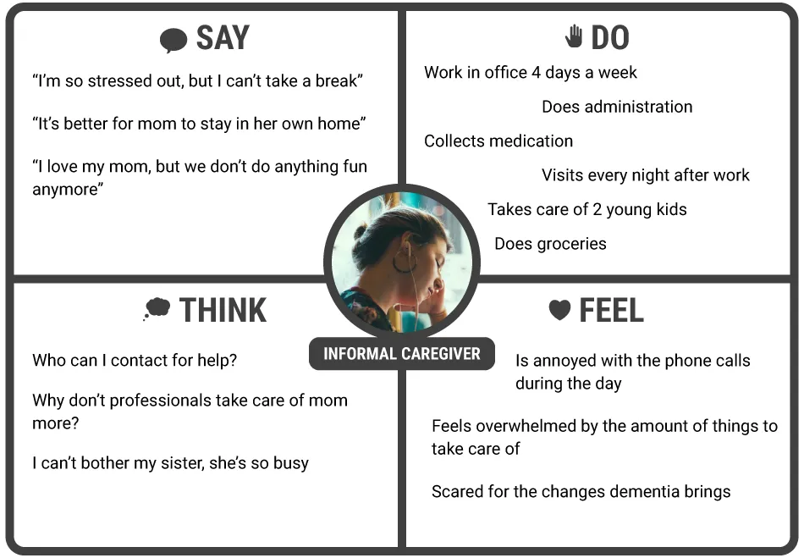

Slide 13
Difference between persona and personality:
Persona is a tool in user-centered design,representing idealized characters to epitomize user types
It aids designers in crafting user centric solutions,focusing on user needs,goals and behaviours.
Conversely Personality refers to the unique characteristics,thoughts, and feelings that differentiate one person another,inherently influencing their interactions and reactions.

Slide 14
Thank You

